Slide 1
Clustering Assignment
Wholesale Customer Dataset
Sathyajith KP
Naheela PK

Slide 2
01
What is Clustering?

Slide 3
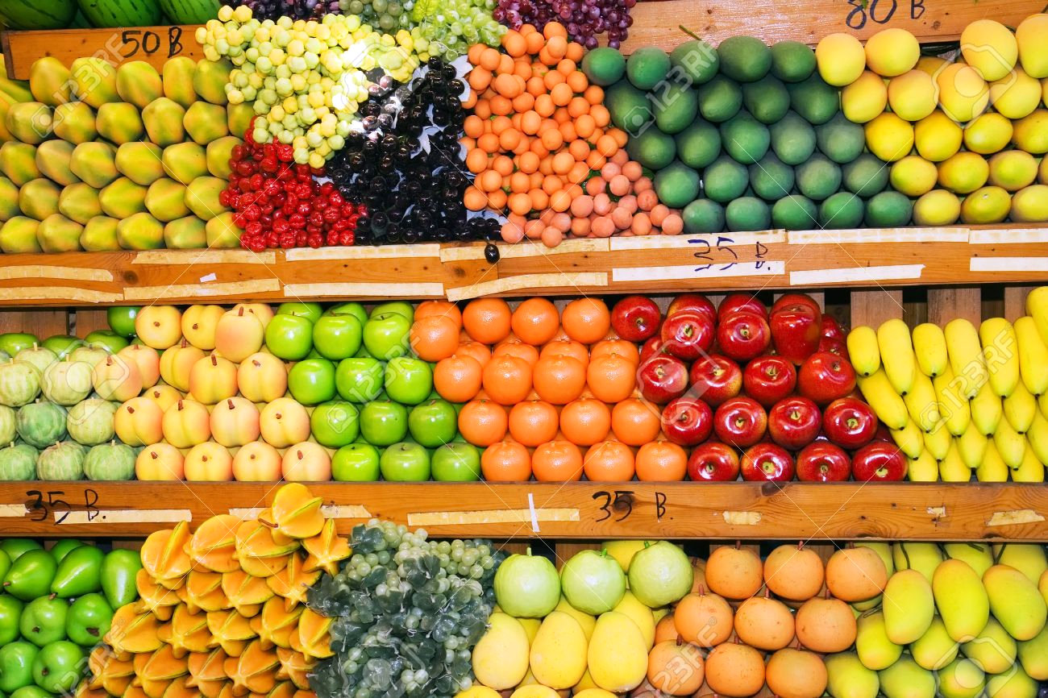
CLUSTERING
Clustering (unsupervised learning) is the task of dividing the population or data points into a number of groups such that data points in the same groups are more similar to other data points in the same group than those in other groups.
In simple words, the aim is to segregate groups with similar traits and assign them into clusters.
We will be performing clustering using
these methods:
K Means Clustering
Agglomerative Clustering
Birch Clustering
MiniBatchKmeans Clustering

Slide 4
DATASET
The dataset has been chosen from the UCI repositories. It refers to clients of a wholesale distributor. It includes the annual spending in monetary units (m.u.) on diverse product categories . The different categories are the attributes
FRESH
MILK
GROCERY
FROZEN
DETERGENTS_PAPER
DELICATESSEN
CHANNEL
REGION
For clustering we will be using only first six attributes
440 instances
8 attributes

Slide 5
02
Clustering methods

Slide 6

K Means clustering
K Means algorithm is an iterative algorithm that tries to partition the dataset into K pre-defined distinct non-overlapping subgroups (clusters).
It assigns data points to a cluster such that the sum of the squared distance between the data points and the cluster’s centroid (arithmetic mean of all the data points that belong to that cluster) is at the minimum.

Slide 7
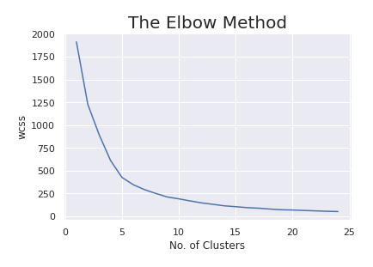
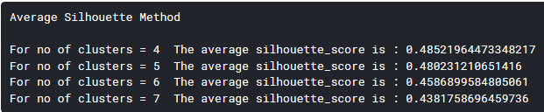
Evaluating K (optimal number of clusters) in K Means
Elbow Method
Silhouette Method
We choose k =5 from the above

Slide 8
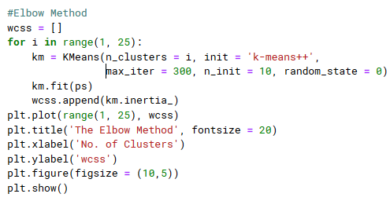
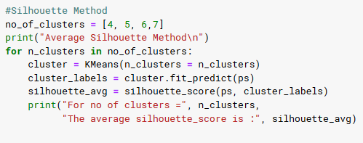
Code for Evaluating K in K Means
Elbow Method
Silhouette Method

Slide 9
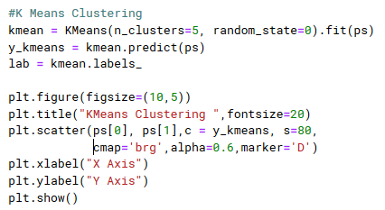
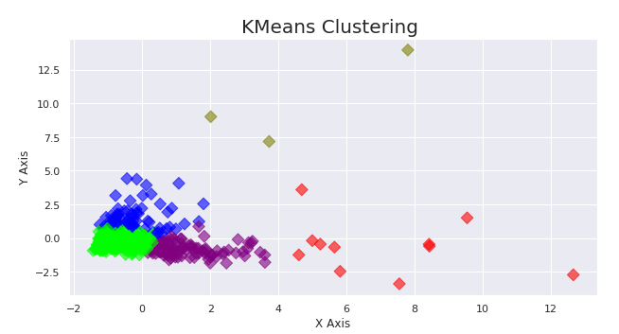
K Means clustering

Slide 10
Mini Batch K Means clustering
Mini Batch K-means algorithm main idea is to use small random batches of data of a fixed size, so they can be stored in memory. Each iteration a new random sample from the dataset is obtained and used to update the clusters and this is repeated until convergence.

Slide 11
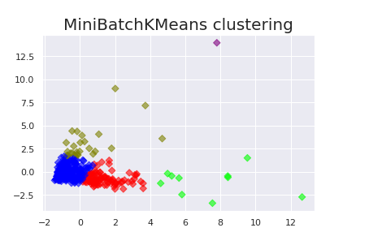
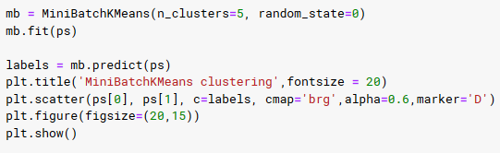
Mini Batch K Means Clustering

Slide 12
Agglomerative Clustering
The Agglomerative Clustering object performs a hierarchical clustering using a bottom up approach: each observation starts in its own cluster, and clusters are successively merged together.
A dendrogram is a diagram that shows the hierarchical relationship between objects. It is most commonly created as an output from hierarchical clustering. The main use of a dendrogram is to work out the best way to allocate objects to clusters.

Slide 13
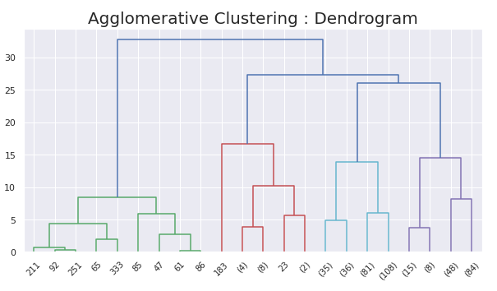
Agglomerative Clustering
Dendrogram

Slide 14
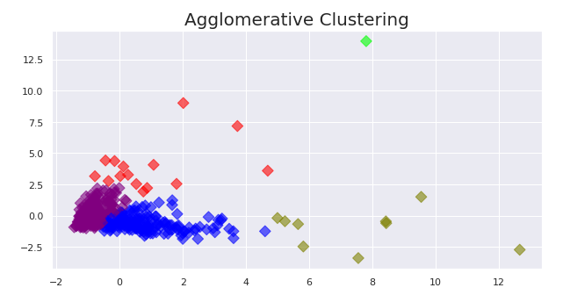
Agglomerative Clustering
Scatterplot

Slide 15
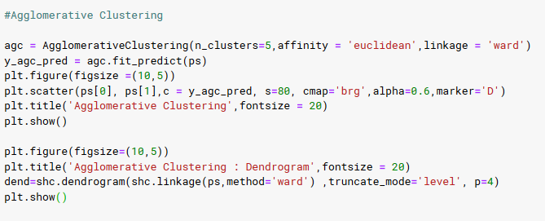
Code for Agglomerative Clustering

Slide 16
Birch Clustering
The BIRCH (balanced iterative reducing and clustering using hierarchies) is an unsupervised data mining algorithm used to perform hierarchical clustering over particularly large data-sets.
An advantage of BIRCH is its ability to incrementally and dynamically cluster incoming, multi-dimensional metric data points in an attempt to produce the best quality clustering for a given set of resources (memory and time constraints).

Slide 17
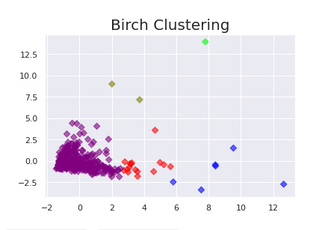
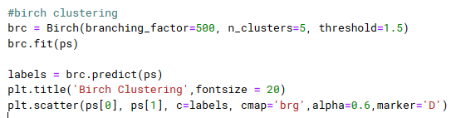
Birch Clustering

Slide 18
03
Conclusion

Slide 19
The dataset has been clustered using 4 algorithms:
K Means Clustering
Agglomerative Clustering
Birch Clustering
MiniBatchKmeans Clustering
Each shows formation of clusters. There are 5 clusters than can be formed from our dataset with maximum similarities. This shows the movement of unsupervised learning.

Slide 20
REFERENCES
REFERENCE WEBSITES
UCI Machine Learning Repository : http://archive.ics.uci.edu/ml/datasets/Wholesale+customers
SkLearn : https://scikit-learn.org/stable/modules/classes.html#module-sklearn.cluster
Wikipedia:
https://en.wikipedia.org/
CODES
Kaggle
https://www.kaggle.com/jithu10/wholesale-customers?scriptVersionId=31864922

Slide 21
THANKS

